Slide 1
Wireless Networks
6CS029 Advanced Networking
Notes:
A Wireless LAN (WLAN) is a type of wireless network that is commonly used in homes, offices, and campus environments. Networks must support people who are on the move. People connect using computers, laptops, tablets, and smart phones. There are many different network infrastructures that provide network access, such as wired LANs, service provider networks, and cell phone networks. But it’s the WLAN that makes mobility possible within the home and business environments.
In businesses with a wireless infrastructure in place, there can be a cost savings any time equipment changes, or when relocating an employee within a building, reorganizing equipment or a lab, or moving to temporary locations or project sites. A wireless infrastructure can adapt to rapidly changing needs and technologies.

Slide 2
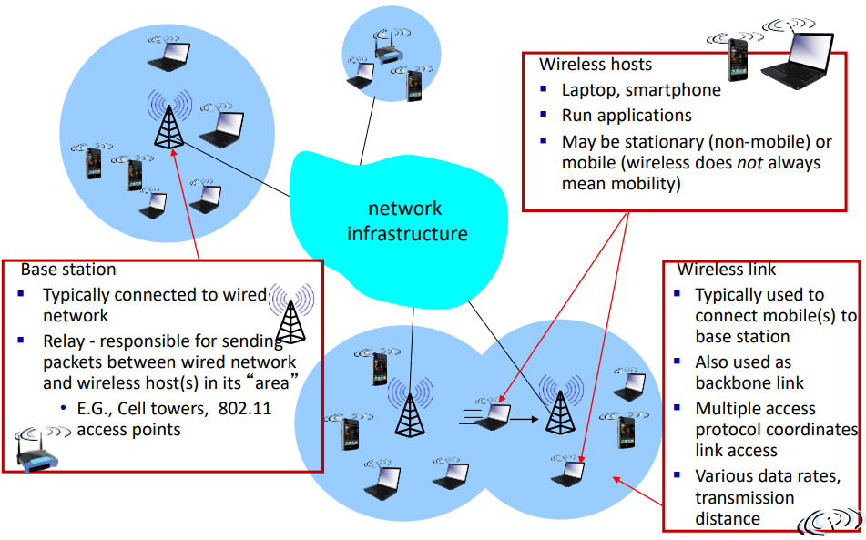
Elements of a wireless network

Slide 3
Wireless Technologies
Wireless networks can be classified broadly as:
Wireless personal-area network (WPAN) – Operates in the range of a few feet
Bluetooth – An IEEE 802.15 WPAN standard; uses a device-pairing process to communicate over distances up to .05 mile (100m).
Wireless LAN (WLAN) – Operates in the range of a few hundred feet.
Wi-Fi (wireless fidelity) – An IEEE 802.11 WLAN standard; provides network access to home and corporate users, to include data, voice and video traffic, to distances up to 0.18 mile (300m).

Slide 4
Wireless Technologies (cont.)
Wireless wide-area network (WWAN) – Operates in the range of miles.
mobile broadband – Consists of various corporate, national, and international organizations using service provider mobile access to provide mobile broadband network connectivity.
Satellite Broadband – Provides network access to remote sites through the use of a directional satellite dish.

Slide 5

Notes:
Starlink, which aims to sell internet connections to almost anyone on the planet,
Starlink wants to sell internet access -- particularly to people in rural areas and other parts of the world who don't already have access to high-speed broadband. by way of a growing network of private satellites orbiting overhead.

Slide 6
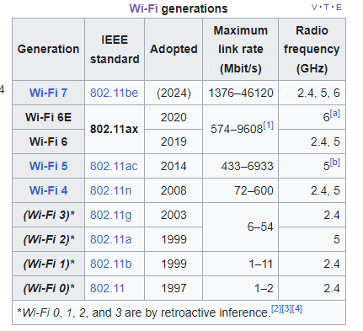
802.11 Standards
Theoretical max 46 Gb/s

Slide 7
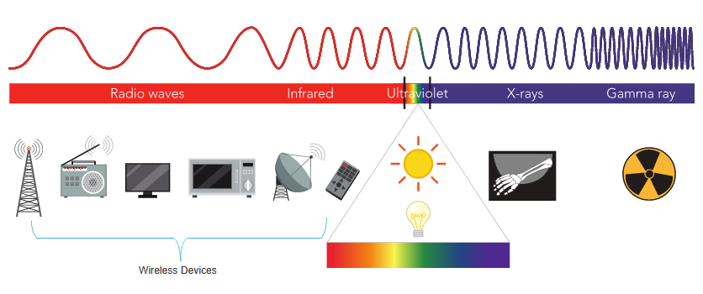
Radio Frequencies
All wireless devices operate in the range of the electromagnetic spectrum. WLAN networks operate in the 2.4 and 5 GHz frequency bands.
2.4 GHz (UHF) – 802.11b/g/n/ax
5 GHz (SHF) – 802.11a/n/ac/ax
2.4, 5 and 6GHz - 802.11 be
5G 3.3 to 3.8GHz
Microwave oven 2.4GHz
Notes:
All wireless devices operate in the radio waves range of the electromagnetic spectrum. WLAN networks operate in the 2.4 GHz frequency band and the 5 GHz band. Wireless LAN devices have transmitters and receivers tuned to specific frequencies of the radio waves range, as shown in Figure 12-5. Specifically, the following frequency bands are allocated to 802.11 wireless LANs:2.4 GHz (UHF) - 802.11b/g/n/ax5 GHz (SHF) - 802.11a/n/ac/ax

Slide 8
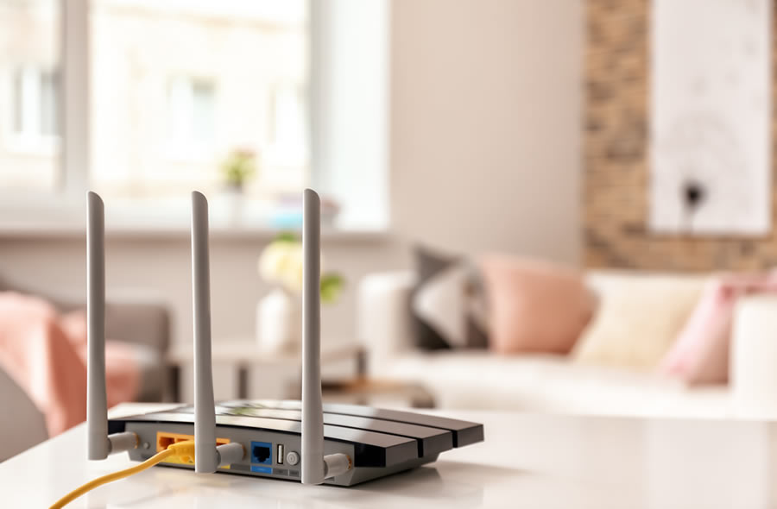
WLAN Components
Wireless Home Router
A home user typically interconnects wireless devices using a small, wireless router.
Wireless routers serve as the following:
Access point – To provide wires access
Switch – To interconnect wired devices
Router - To provide a default gateway to other networks and the Internet
Notes:
Wireless deployments require a minimum of two devices that have a radio transmitter and a radio receiver tuned to the same radio frequencies:
End devices with wireless NICs
A network device, such as a wireless router or wireless AP
To communicate wirelessly, laptops, tablets, smart phones, and even the latest automobiles include integrated wireless NICs that incorporate a radio transmitter/receiver. However, if a device does not have an integrated wireless NIC, then a USB wireless adapter can be used
Note: Many wireless devices you are familiar with do not have visible antennas. They are embedded inside smartphones, laptops, and wireless home routers.
A wireless router is commonly implemented as a small business or residential wireless access device. The wireless router advertises its wireless services by sending beacons containing its shared service set identifier (SSID). Devices wirelessly discover the SSID and attempt to associate and authenticate with it to access the local network and internet.
Most wireless routers also provide advanced features, such as high-speed access, support for video streaming, IPv6 addressing, quality of service (QoS), configuration utilities, and USB ports to connect printers or portable drives.
Additionally, home users who want to extend their network services can implement Wi-Fi range extenders. A device can connect wirelessly to the extender, which boosts its communications to be repeated to the wireless router.

Slide 9
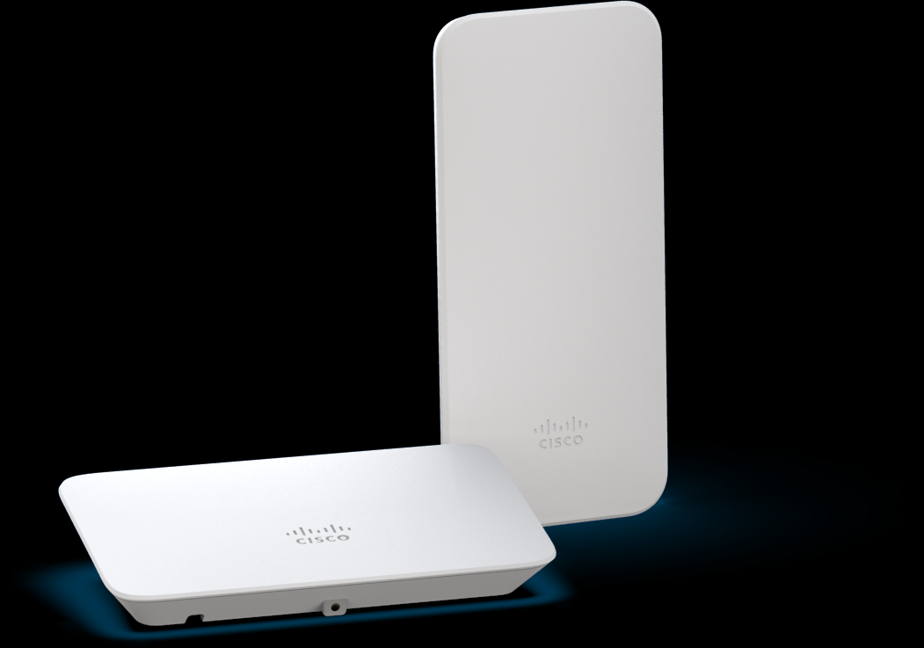
Wireless Access Point
Wireless clients use their wireless NIC to discover nearby access points (APs).
Clients then attempt to associate and authenticate with an AP.
After being authenticated, wireless users have access to network resources.
Cisco Meraki Go access points
Notes:
While range extenders are easy to set up and configure, the best solution would be to install another wireless access point to provide dedicated wireless access to the user devices. Wireless clients use their wireless NIC to discover nearby APs advertising their SSID. Clients then attempt to associate and authenticate with an AP. After being authenticated, wireless users have access to network resources. The Cisco Meraki Go APs are shown in the figure.
Most business class APs require external antennas to make them fully functioning units.

Slide 10
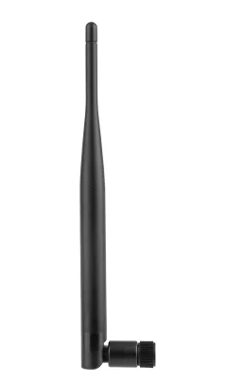
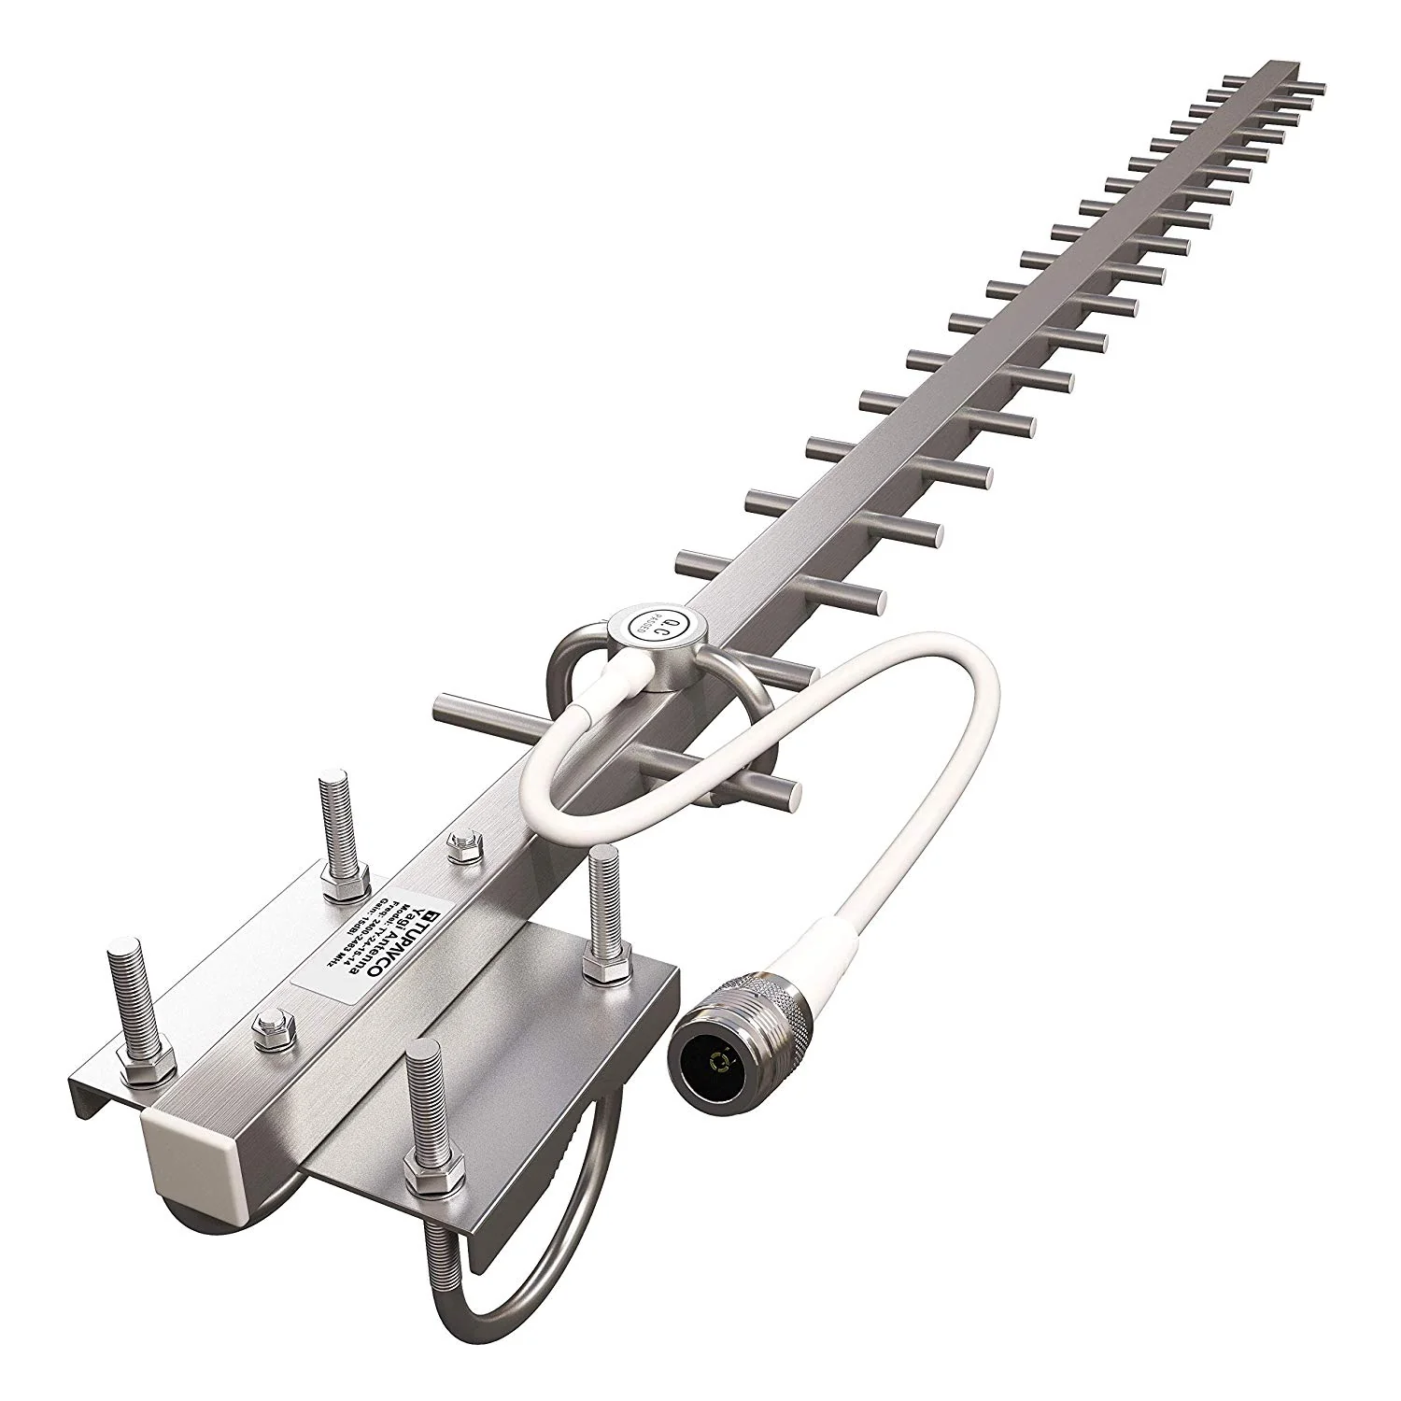
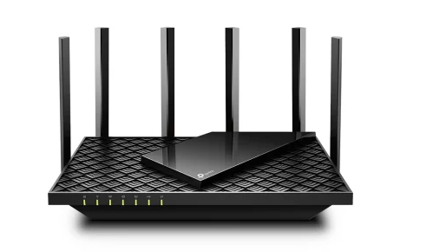
Aerials for external use
Omnidirectional – Provide 360-degree coverage. Ideal in houses and office areas
Directional – Focus the radio signal in a specific direction. Examples are the Yagi and parabolic dish.
Multiple Input Multiple Output (MIMO) – Uses multiple antennas (Up to eight) to increase bandwidth

Slide 11
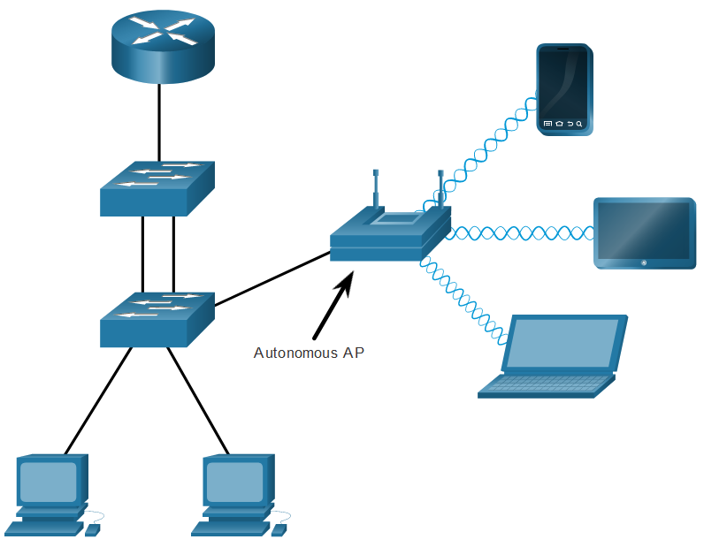
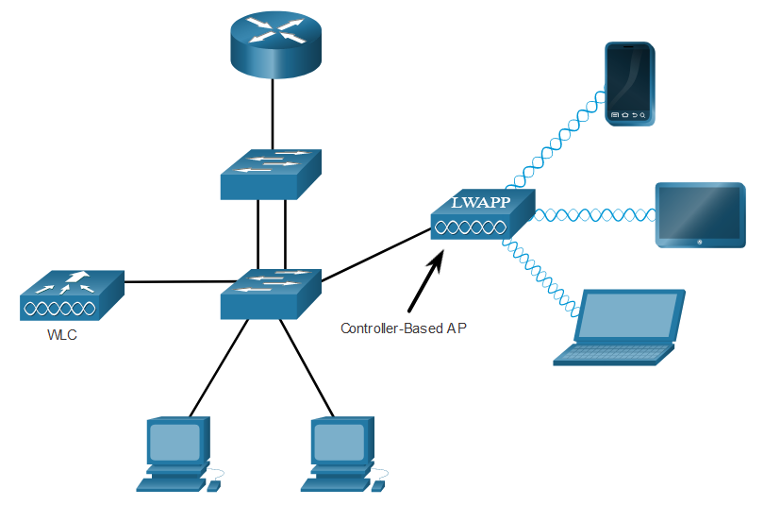
AP Categories
Autonomous APs – Standalone devices. Each autonomous AP acts independently of the others and is configured and managed manually by an administrator.
Controller-based APs – Also known as lightweight APs (LAPs). Use Lightweight Access Point Protocol (LWAPP) to communicate with a LWAN controller (WLC). Each LAP is automatically configured and managed by the WLC.
Notes:
Autonomous APs
These are standalone devices configured using a command line interface or a GUI, as shown in the figure. Autonomous APs are useful in situations where only a couple of APs are required in the organization. A home router is an example of an autonomous AP because the entire AP configuration resides on the device. If the wireless demands increase, more APs would be required. Each AP would operate independent of other APs and each AP would require manual configuration and management. This would become overwhelming if many APs were needed.
Controller-based APs
These devices require no initial configuration and are often called lightweight APs (LAPs). LAPs use the Lightweight Access Point Protocol (LWAPP) to communicate with a WLAN controller (WLC), as shown in the next figure. Controller-based APs are useful in situations where many APs are required in the network. As more APs are added, each AP is automatically configured and managed by the WLC.
Notice in the figure that the WLC has four ports connected to the switching infrastructure. These four ports are configured as a link aggregation group (LAG) to bundle them together. Much like how EtherChannel operates, LAG provides redundancy and load-balancing. All the ports on the switch that are connected to the WLC need to be trunking and configured with EtherChannel on. However, LAG does not operate exactly like EtherChannel. The WLC does not support Port Aggregation Protocol (PaGP) or Link Aggregation Control Protocol (LACP).

Slide 12
WLAN Operation

Slide 13

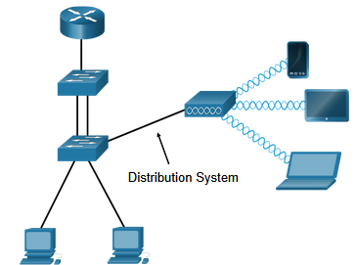
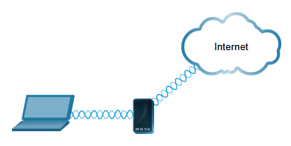
802.11 Wireless Topology Modes
Ad hoc mode - Used to connect clients in peer-to-peer manner without an AP.
Infrastructure mode - Used to connect clients to the network using an AP.
Tethering - Variation of the ad hoc topology is when a smart phone or tablet with mobile data access is enabled to create a personal hotspot.
Notes:
Ad hoc mode - This is when two devices connect wirelessly in a peer-to-peer (P2P) manner without using APs or wireless routers. Examples include wireless clients connecting directly to each other using Bluetooth or Wi-Fi Direct. The IEEE 802.11 standard refers to an ad hoc network as an independent basic service set (IBSS).
Infrastructure mode - This is when wireless clients interconnect via a wireless router or AP, such as in WLANs. APs connect to the network infrastructure using the wired distribution system, such as Ethernet.
Tethering - A variation of the ad hoc topology is when a smart phone or tablet with cellular data access is enabled to create a personal hotspot. This feature is sometimes referred to as tethering. A hotspot is usually a temporary quick solution that enables a smart phone to provide the wireless services of a Wi-Fi router. Other devices can associate and authenticate with the smart phone to use the internet connection.

Slide 14
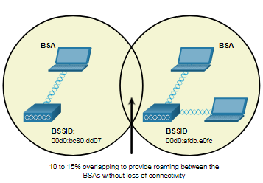
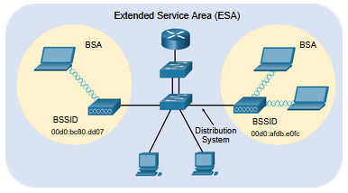
BSS and ESS
Infrastructure mode defines two topology blocks:
Basic Service Set (BSS)
Uses single AP to interconnect all associated wireless clients.
Clients in different BSSs cannot communicate.
Extended Service Set (ESS)
A union of two or more BSSs interconnected by a wired distribution system.
Clients in each BSS can communication through the ESS.
BSS and ESS
Notes:
Basic Service Set
A BSS consists of a single AP interconnecting all associated wireless clients. Two BSSs are shown in the figure. The circles depict the coverage area for the BSS, which is called the Basic Service Area (BSA). If a wireless client moves out of its BSA, it can no longer directly communicate with other wireless clients within the BSA.
The Layer 2 MAC address of the AP is used to uniquely identify each BSS, which is called the Basic Service Set Identifier (BSSID). Therefore, the BSSID is the formal name of the BSS and is always associated with only one AP.
Extended Service Set
When a single BSS provides insufficient coverage, two or more BSSs can be joined through a common distribution system (DS) into an ESS. An ESS is the union of two or more BSSs interconnected by a wired DS. Each ESS is identified by a SSID and each BSS is identified by its BSSID.
Wireless clients in one BSA can now communicate with wireless clients in another BSA within the same ESS. Roaming mobile wireless clients may move from one BSA to another (within the same ESS) and seamlessly connect.
The rectangular area in the figure depicts the coverage area within which members of an ESS may communicate. This area is called the Extended Service Area (ESA).

Slide 15
Transition Types Based On Mobility
No transition
Stationary or moves only within BSS
BSS transition
Station moving from one BSS to another BSS in same ESS
ESS transition
Station moving from BSS in one ESS to BSS within another ESS

Slide 16
Wireless Link Characteristics
Important differences from wired link ….
Decreased signal strength: radio signal attenuates as it propagates through matter (path loss)
Interference from other sources: standardized wireless network frequencies (e.g., 2.4 ghz) shared by other devices (e.g., Phone); devices (motors) interfere as well
Multipath propagation: radio signal reflects off objects ground, arriving at destination at slightly different times
Make communication across (even a point to point) wireless link much more “difficult”

Slide 17
Medium Access Control
MAC layer covers three functional areas:
Reliable data delivery
More efficient to deal with errors at the MAC level than higher layer (such as TCP)
Frame exchange protocol
Source station transmits data
Destination responds with acknowledgment (ACK)
If source doesn‘t receive ACK, it retransmits frame
Access control
Avoiding collisions
Carrier Sense Multiple Access/ Collision Avoidance (CSMA/CA)
Security

Slide 18
CSMA/CA
WLANs are half-duplex and a client cannot “hear” while it is sending, making it impossible to detect a collision.
WLANs use carrier sense multiple access with collision avoidance (CSMA/CA) to determine how and when to send data. A wireless client does the following:
Listens to the channel to see if it is idle, i.e. no other traffic currently on the channel.
Sends a ready to send (RTS) message the AP to request dedicated access to the network.
Receives a clear to send (CTS) message from the AP granting access to send.
Waits a random amount of time before restarting the process if no CTS message received.
Transmits the data.
Acknowledges all transmissions. If a wireless client does not receive an acknowledgment, it assumes a collision occurred and restarts the process

Slide 19






Collision Avoidance: RTS-CTS exchange
A
B
AP
reservation collision
DATA (A)
defer
time

Slide 20
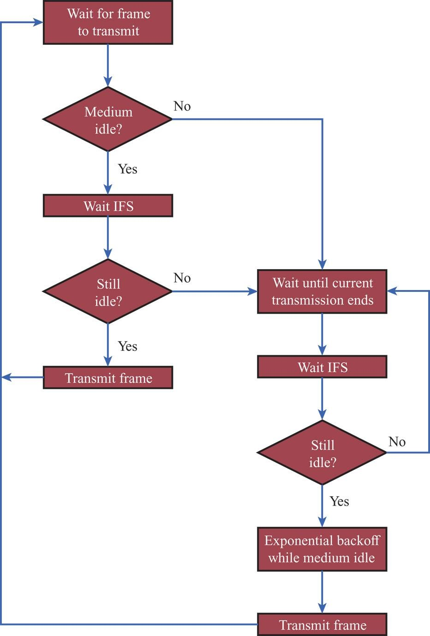
IEEE 802.11
Medium Access Control Logic

Slide 21
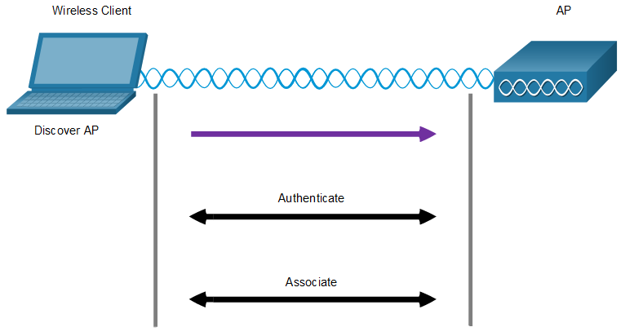
Wireless Client and AP Association
Wireless devices must associate with an AP or wireless router.
Wireless devices complete the following three stage process:
Discover a wireless AP
Authenticate with the AP
Associate with the AP – link to it to act as bridge into the network
A wireless client and an AP must agree on specific parameters:
SSID – The client needs to know the name of the network to connect.
Password – This is required for the client to authenticate to the AP.
Network mode – The 802.11 standard in use x, n etc
Security mode – The security parameter settings, i.e. WEP, WPA, or WPA2.
Channel settings – The frequency bands in use.
AP association
Notes:
To achieve successful association, a wireless client and an AP must agree on specific parameters:
SSID – The client needs to know the name of the network to connect.
Password – This is required for the client to authenticate to the AP.
Network mode – The 802.11 standard in use.
Security mode – The security parameter settings, i.e. WEP, WPA, or WPA2.
Channel settings – The frequency bands in use.

Slide 22
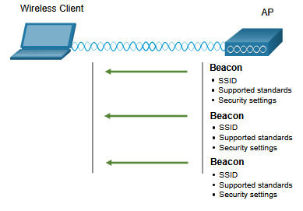
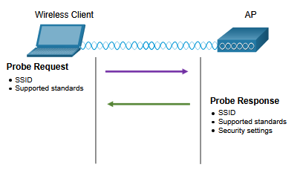
Discover Mode
Wireless clients connect to the AP using a passive or active scanning (probing) process.
Passive mode – AP openly advertises its service by periodically sending broadcast beacon frames containing the SSID, supported standards, and security settings.
Active mode – Wireless clients must know the name of the SSID. The wireless client initiates the process by broadcasting a probe request frame on multiple channels.
Passive mode
Active mode
Notes:
In passive mode, the AP openly advertises its service by periodically sending broadcast beacon frames containing the SSID, supported standards, and security settings. The primary purpose of the beacon is to allow wireless clients to learn which networks and APs are available in a given area. This allows the wireless clients to choose which network and AP to use.
In active mode, wireless clients must know the name of the SSID. The wireless client initiates the process by broadcasting a probe request frame on multiple channels. The probe request includes the SSID name and standards supported. APs configured with the SSID will send a probe response that includes the SSID, supported standards, and security settings. Active mode may be required if an AP or wireless router is configured to not broadcast beacon frames.
A wireless client could also send a probe request without a SSID name to discover nearby WLAN networks. APs configured to broadcast beacon frames would respond to the wireless client with a probe response and provide the SSID name. APs with the broadcast SSID feature disabled do not respond.

Slide 23
Association-Related Services
Association
Establishes initial association between station and AP
Reassociation
Enables transfer of association from one AP to another, allowing station to move from one BSS to another
Disassociation
Association termination notice from station or AP

Slide 24
Control and Provisioning of Wireless Access Points (CAPWAP)

Slide 25
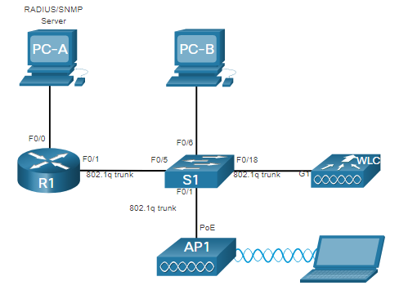
WLC Topology
The access point (AP) is a controller-based AP as opposed to an autonomous AP, so it requires no initial configuration and is often called lightweight APs (LAPs).
LAPs use the Lightweight Access Point Protocol (LWAPP) to communicate with a WLAN controller (WLC).
Controller-based APs are useful in situations where many APs are required in the network.
As more APs are added, each AP is automatically configured and managed by the WLC.
WLC

Slide 26
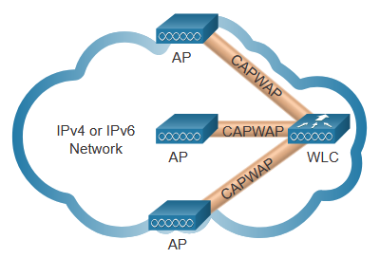
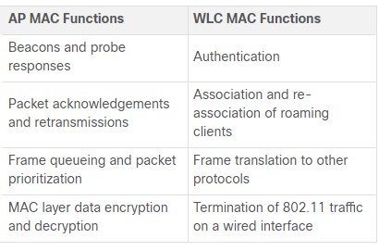
CAPWAP
IEEE standard protocol that enables a WLC to manage multiple APs and WLANs.
Based on LWAPP but adds additional security with Datagram Transport Layer Security (DLTS).
Encapsulates and forwards WLAN client traffic between an AP and a WLC over tunnels using UDP ports 5246 and 5247.
Operates over both IPv4 and IPv6. IPv4 uses IP protocol 17 and IPv6 uses IP protocol 136.
MAC functions are split between WLC and APs
CAPWAP explained
Notes:
Lightweight Access Point Protocol (LWAPP) is the name of a protocol that can control multiple Wi-Fi wireless access points at once. This can reduce the amount of time spent on configuring, monitoring or troubleshooting a large network. The system will also allow network administrators to closely analyze the network.
This system is installed in a central server that gathers data from RF devices from different brands and settings. The server can command a selected group of devices to apply given settings simultaneously.
CAPWAP is an IEEE standard protocol that enables a WLC to manage multiple APs and WLANs. CAPWAP is also responsible for the encapsulation and forwarding of WLAN client traffic between an AP and a WLC.
CAPWAP is based on LWAPP but adds additional security with Datagram Transport Layer Security (DTLS). CAPWAP establishes tunnels on User Datagram Protocol (UDP) ports. CAPWAP can operate either over IPv4 or IPv6, as shown in the figure, but uses IPv4 by default.
IPv4 and IPv6 both use UDP ports 5246 and 5247. Port 5246 is for CAPWAP control messages used by the WLC to manage the AP. Port 5247 is used by CAPWAP to encapsulate data packets traveling to and from wireless clients. However, CAPWAP tunnels use different IP protocols in the packet header. IPv4 uses IP protocol 17 and IPv6 uses IP protocol 136.
A key component of CAPWAP is the concept of a split media access control (MAC). The CAPWAP split MAC concept does all of the functions normally performed by individual APs and distributes them between two functional components:
AP MAC Functions
WLC MAC Functions
The table shows some of the MAC functions performed by each.

Slide 27
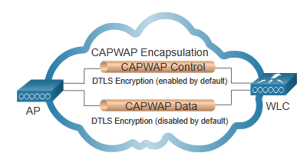
Datagram Transport Layer Security (DTLS)
DTLS provides security between the AP and the WLC.
It is enabled by default to secure the CAPWAP control channel and encrypt all management and control traffic between AP and WLC.
Data encryption is disabled by default and requires a DTLS license to be installed on the WLC before it can be enabled on the AP.
Notes:
DTLS Datagram Transport Layer Security is a protocol which provides security between the AP and the WLC. It allows them to communicate using encryption and prevents eavesdropping or tampering.
DTLS is enabled by default to secure the CAPWAP control channel but is disabled by default for the data channel, as shown in the figure. All CAPWAP management and control traffic exchanged between an AP and WLC is encrypted and secured by default to provide control plane privacy and prevent Man-In-the-Middle (MITM) attacks.
CAPWAP data encryption is optional and is enabled per AP. Data encryption requires a DTLS license to be installed on the WLC prior to being enabled on an AP. When enabled, all WLAN client traffic is encrypted at the AP before being forwarded to the WLC and vice versa.

Slide 28
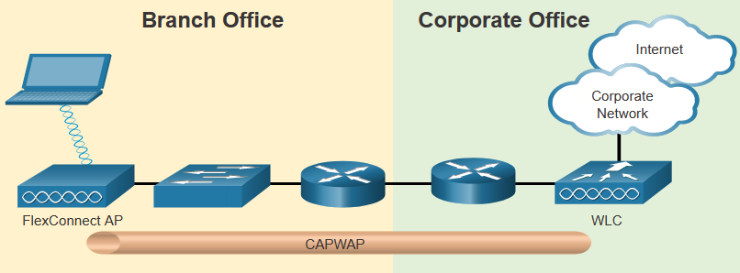
Flex Connect APs
FlexConnect enables the configuration and control of Aps over a WAN link.
Connected mode – The WLC is reachable. The FlexConnect AP has CAPWAP connectivity with the WLC through the CAPWAP tunnel. The WLC performs all CAPWAP functions.
Standalone mode – The WLC is unreachable. The FlexConnect AP has lost CAPWAP connectivity with the WLC. The FlexConnect AP can assume some of the WLC functions such as switching client data traffic locally and performing client authentication locally.
Notes:
FlexConnect is a wireless solution for branch office and remote office deployments. It lets you configure and control access points in a branch office from the corporate office through a WAN link, without deploying a controller in each office.
There are two modes of operation for the FlexConnect AP.
Connected mode - The WLC is reachable. In this mode the FlexConnect AP has CAPWAP connectivity with its WLC and can send traffic through the CAPWAP tunnel, as shown in the figure. The WLC performs all its CAPWAP functions.
Standalone mode - The WLC is unreachable. The FlexConnect has lost or failed to establish CAPWAP connectivity with its WLC. In this mode, a FlexConnect AP can assume some of the WLC functions such as switching client data traffic locally and performing client authentication locally.
The figure shows a CAPWAP tunnel formed between a FlexConnect AP at a branch office and a WLC at a corporate office. The branch office equipment consists of a laptop with a wireless connection to a FlexConnect AP which is connected to a switch which is connected to a router. The router is then connected to another router in the corporate office to which the WLC is connected. The WLC provides access into the corporate network and the Internet.

Slide 29
Channel Management

Slide 30
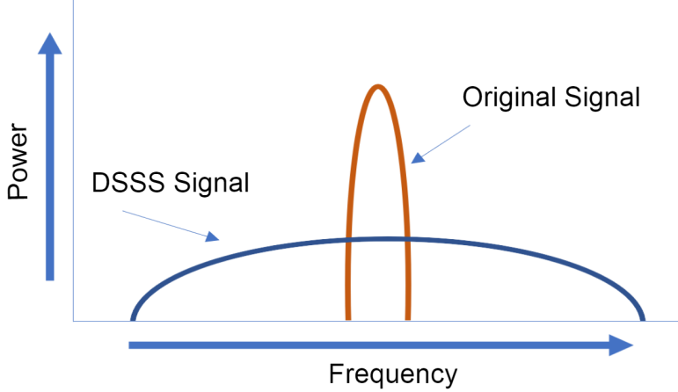
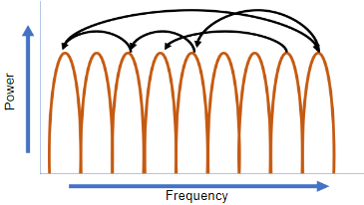
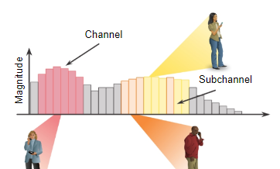
Frequency Channel Saturation
Channel saturation can be mitigated using techniques that use the channels more efficiently.
Direct-Sequence Spread Spectrum (DSSS) - A modulation technique designed to spread a signal over a larger frequency band.
Frequency-Hopping Spread Spectrum (FHSS) - Transmits radio signals by rapidly switching a carrier signal among many frequency channels. Sender and receiver must be synchronized to “know” which channel to jump to. Used by the original 802.11 standard.
Orthogonal Frequency-Division Multiplexing (OFDM) - A subset of frequency division multiplexing in which a single channel uses multiple sub-channels on adjacent frequencies. OFDM is used by a number of communication systems including 802.11a/g/n/ac. 5G
Quadrature Amplitude Modulation – used by WiFi 7, this involves only the amplitude of the wave but also the phase
Notes:
Wireless LAN devices have transmitters and receivers tuned to specific frequencies of radio waves to communicate. A common practice is for frequencies to be allocated as ranges. Such ranges are then split into smaller ranges called channels.
If the demand for a specific channel is too high, that channel is likely to become oversaturated. The saturation of the wireless medium degrades the quality of the communication. Over the years, a number of techniques have been created to improve wireless communication and alleviate saturation. These techniques mitigate channel saturation by using the channels in a more efficient way.
Direct-Sequence Spread Spectrum (DSSS) - This is a modulation technique designed to spread a signal over a larger frequency band. Spread spectrum techniques were developed during war time to make it more difficult for enemies to intercept or jam a communication signal. It does this by spreading the signal over a wider frequency which effectively hides the discernable peak of the signal, as shown in the figure. A properly configured receiver can reverse the DSSS modulation and re-construct the original signal. DSSS is used by 802.11b devices to avoid interference from other devices using the same 2.4 GHz frequency.
Frequency-Hopping Spread Spectrum (FHSS) - This relies on spread spectrum methods to communicate. It transmits radio signals by rapidly switching a carrier signal among many frequency channels. With the FHSS, the sender and receiver must be synchronized to “know” which channel to jump to. This channel hopping process allows for a more efficient usage of the channels, decreasing channel congestion. FHSS was used by the original 802.11 standard. Walkie-talkies and 900 MHz cordless phones also use FHSS, and Bluetooth uses a variation of FHSS.
Orthogonal Frequency-Division Multiplexing (OFDM) - This is a subset of frequency division multiplexing in which a single channel uses multiple sub-channels on adjacent frequencies. Sub-channels in an OFDM system are precisely orthogonal to one another which allow the sub-channels to overlap without interfering. OFDM is used by a number of communication systems including 802.11a/g/n/ac. The new 802.11ax uses a variation of OFDM called Orthogonal frequency-division multiaccess (OFDMA).

Slide 31
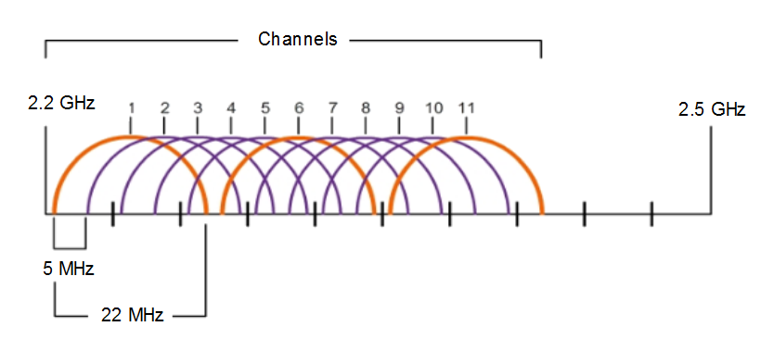
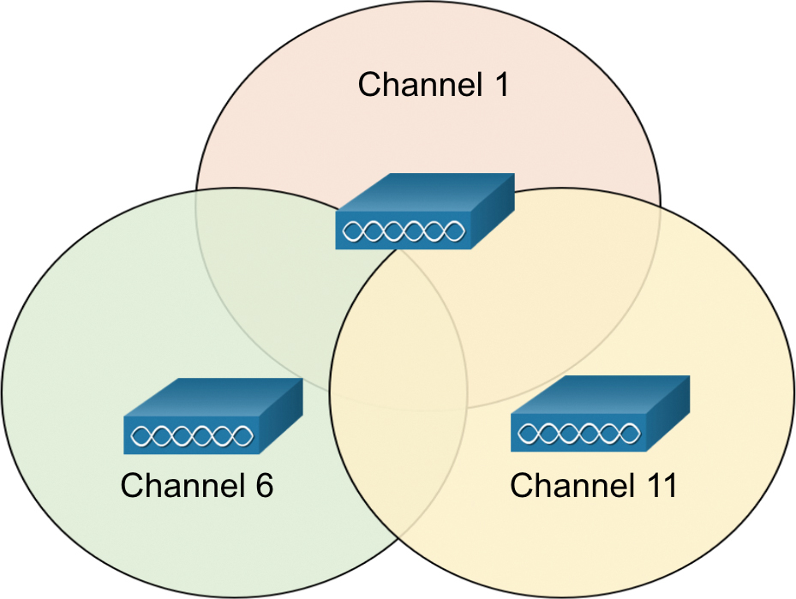
Channel Selection
The 2.4 GHz band is subdivided into multiple channels each allotted 22 MHz bandwidth and separated from the next channel by 5 MHz.
A best practice for 802.11b/g/n WLANs requiring multiple APs is to use non-overlapping channels such as 1, 6, and 11.
Notes:
A best practice for WLANs requiring multiple APs is to use non-overlapping channels. For example, the 802.11b/g/n standards operate in the 2.4 GHz to 2.5 GHz spectrum. The 2.4 GHz band is subdivided into multiple channels. Each channel is allotted 22 MHz bandwidth and is separated from the next channel by 5 MHz. The 802.11b standard identifies 11 channels for North America, as shown in Figure 12-29 (13 in Europe and 14 in Japan).
Note: Search the internet for 2.4 GHz channels to learn more about the variations for different countries.

Slide 32
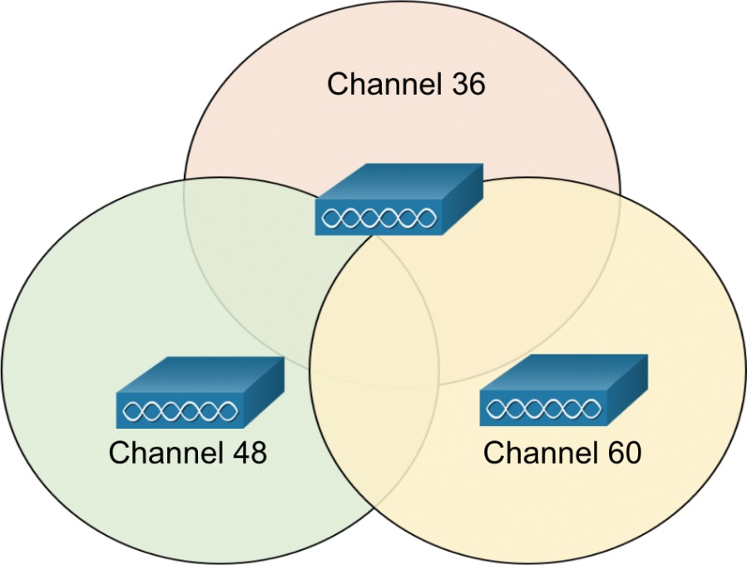
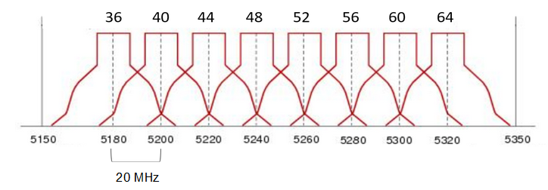
Channel Selection
For the 5GHz standards 802.11a/n/ac, there are 24 channels. Each channel is separated from the next channel by 20 MHz.
Non-overlapping channels are 36, 48, and 60.

Slide 33
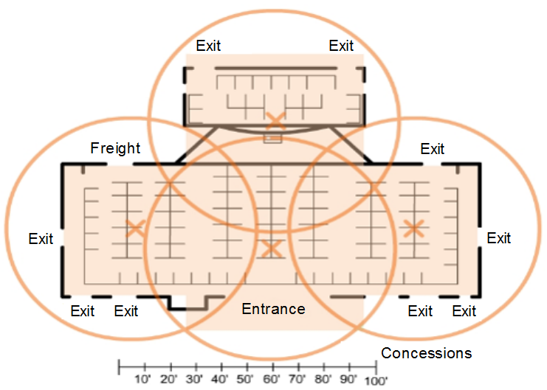
Plan a WLAN Deployment
The number of users supported by a WLAN depends on the following:
The geographical layout of the facility
The number of bodies and devices that can fit in a space
The data rates users expect
The use of non-overlapping channels by multiple APs and transmit power settings
When planning the location of APs, the approximate circular coverage area is important.
Notes:
The number of users supported by a WLAN depends on the geographical layout of the facility, including the number of bodies and devices that can fit in a space, the data rates users expect, the use of non-overlapping channels by multiple APs in an ESS, and transmit power settings.
When planning the location of APs, the approximate circular coverage area is important
However, there are some additional recommendations:
If APs are to use existing wiring, or if there are locations where APs cannot be placed, note these locations on the map.
Note all potential sources of interference, which can include microwave ovens, wireless video cameras, fluorescent lights, motion detectors, or any other device that uses the 2.4 GHz range.
Position APs above obstructions.
Position APs vertically near the ceiling in the center of each coverage area, if possible.
Position APs in locations where users are expected to be. For example, conference rooms are typically a better location for APs than a hallway.
If an IEEE 802.11 network has been configured for mixed mode, the wireless clients may experience slower than normal speeds to support the older wireless standards.
When estimating the expected coverage area of an AP, realize that this value varies depending on the WLAN standard or mix of standards that are deployed, the nature of the facility, and the transmit power that the AP is configured for. Always consult the specifications for the AP when planning for coverage areas.

Slide 34
Wireless Security
A WLAN is open to anyone within range of an AP and the appropriate credentials to associate to it.
Wireless networks are specifically susceptible to several threats, including the following:
Interception of data
Wireless intruders
Denial of Service (DoS) Attacks
Rogue Aps
Secure WLANs
SSID cloaking – use active mode and clients must know the SSID
MAC addresses filtering
Authentication and Encryption Systems
Notes:
A WLAN is open to anyone within range of an AP and the appropriate credentials to associate to it.
Attacks can be generated by outsiders, disgruntled employees, and even unintentionally by employees. Wireless networks are specifically susceptible to several threats, including the following:
Interception of data
Wireless intruders
Denial of Service (DoS) Attacks
Rogue Aps
Wireless signals can travel through solid matter, such as ceilings, floors, walls, outside of the home, or office space. Without stringent security measures in place, installing a WLAN can be the equivalent of putting Ethernet ports everywhere, even outside.
To address the threats of keeping wireless intruders out and protecting data, two early security features were used and are still available on most routers and APs: SSID cloaking and MAC address filtering.
SSID Cloaking
APs and some wireless routers allow the SSID beacon frame to be disabled, as shown Figure 12-38. Wireless clients must manually configure the SSID to connect to the network. This is referred to as active mode because the wireless clients must know the name of the SSID.
MAC Addresses Filtering
An administrator can manually permit or deny clients wireless access based on their physical MAC hardware address. In Figure 12-39, the router is configured to permit two MAC addresses. Devices with different MAC addresses will not be able to join the 2.4GHz WLAN.
The best way to secure a wireless network is to use authentication and encryption systems. Two types of authentication were introduced with the original 802.11 standard:
Open system authentication
No password required. Typically used to provide free internet access in public areas like cafes, airports, and hotels.
Client is responsible for providing security such as through a VPN.
Shared key authentication
Provides mechanisms, such as WEP, WPA, WPA2, and WPA3 to authenticate and encrypt data between a wireless client and AP. However, the password must be pre-shared between both parties to connect.

Slide 35
WLAN Configuration

Slide 36
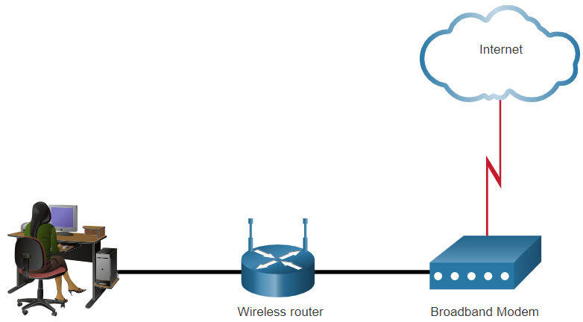
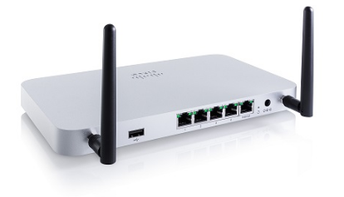
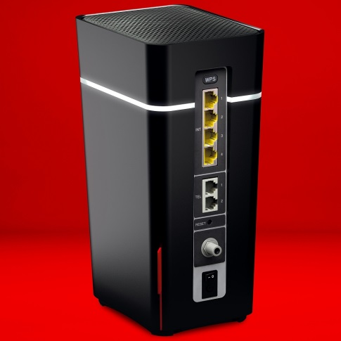
The Wireless Router
Remote workers, small branch offices, and home networks often use a small office and home router.
These “integrated” routers typically include a switch for wired clients, a port for an internet connection (sometimes labeled “WAN”), and wireless components for wireless client access.
These wireless routers typically provide WLAN security, DHCP services, integrated Network Address Translation (NAT), quality of service (QoS), as well as a variety of other features.
The feature set will vary based on the router model.
Notes:
Remote workers, small branch offices, and home networks often use a small office and home router. These routers are sometimes called an integrated router because they typically include a switch for wired clients, a port for an Internet connection (sometimes labeled “WAN”), and wireless components for wireless client access, as shown for the Cisco Meraki MX64W in Figure 13-1. For the rest of this module, small office and home routers are referred to as wireless routers.
Most wireless routers are preconfigured to be connected to the network and provide services.
Wireless router default IP addresses, usernames, and passwords can easily be found on the internet.
Therefore, your first priority should be to change these defaults for security reasons.
To gain access to the wireless router’s configuration GUI
Open a web browser and enter the default IP address for your wireless router.
The default IP address can be found in the documentation that came with the wireless router or you can search the internet.
The word admin is commonly used as the default username and password.

Slide 37
Basic Network Setup
Basic network setup includes the following steps:
Log in to the router from a web browser.
Change the default administrative password.
Log in with the new administrative password.
Change the default DHCP IPv4 addresses.
Renew the IP address.
Log in to the router with the new IP address.
Basic wireless setup includes the following steps:
View the WLAN defaults.
Change the network mode, identifying which 802.11 standard is to be implemented.
Configure the SSID.
Configure the channel, ensuring there are no overlapping channels in use.
Configure the security mode, selecting from Open, WPA, WPA2 Personal, WPA2 Enterprise, etc..
Configure the passphrase, as required for the selected security mode.

Slide 38
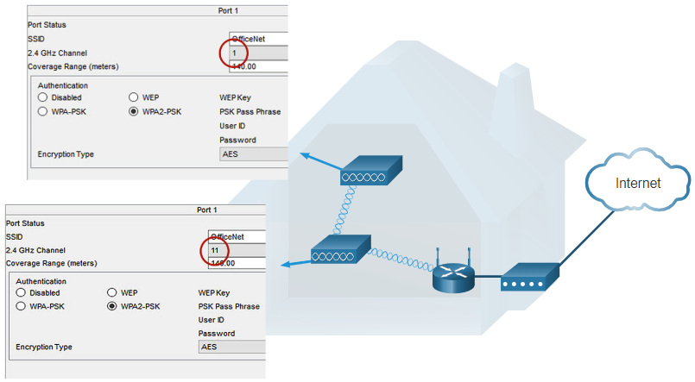
Wireless Mesh Network
In a small office or home network, one wireless router may suffice to provide wireless access to all the clients.
If you want to extend the range beyond approximately 45 meters indoors and 90 meters outdoors, you create a wireless mesh.
Create the mesh by adding access points with the same settings, except using different channels to prevent interference.
Extending a WLAN in a small office or home has become increasingly easier.
Manufacturers have made creating a wireless mesh network (WMN) simple through smartphone apps.

Slide 39
Questions?

